Slide 1

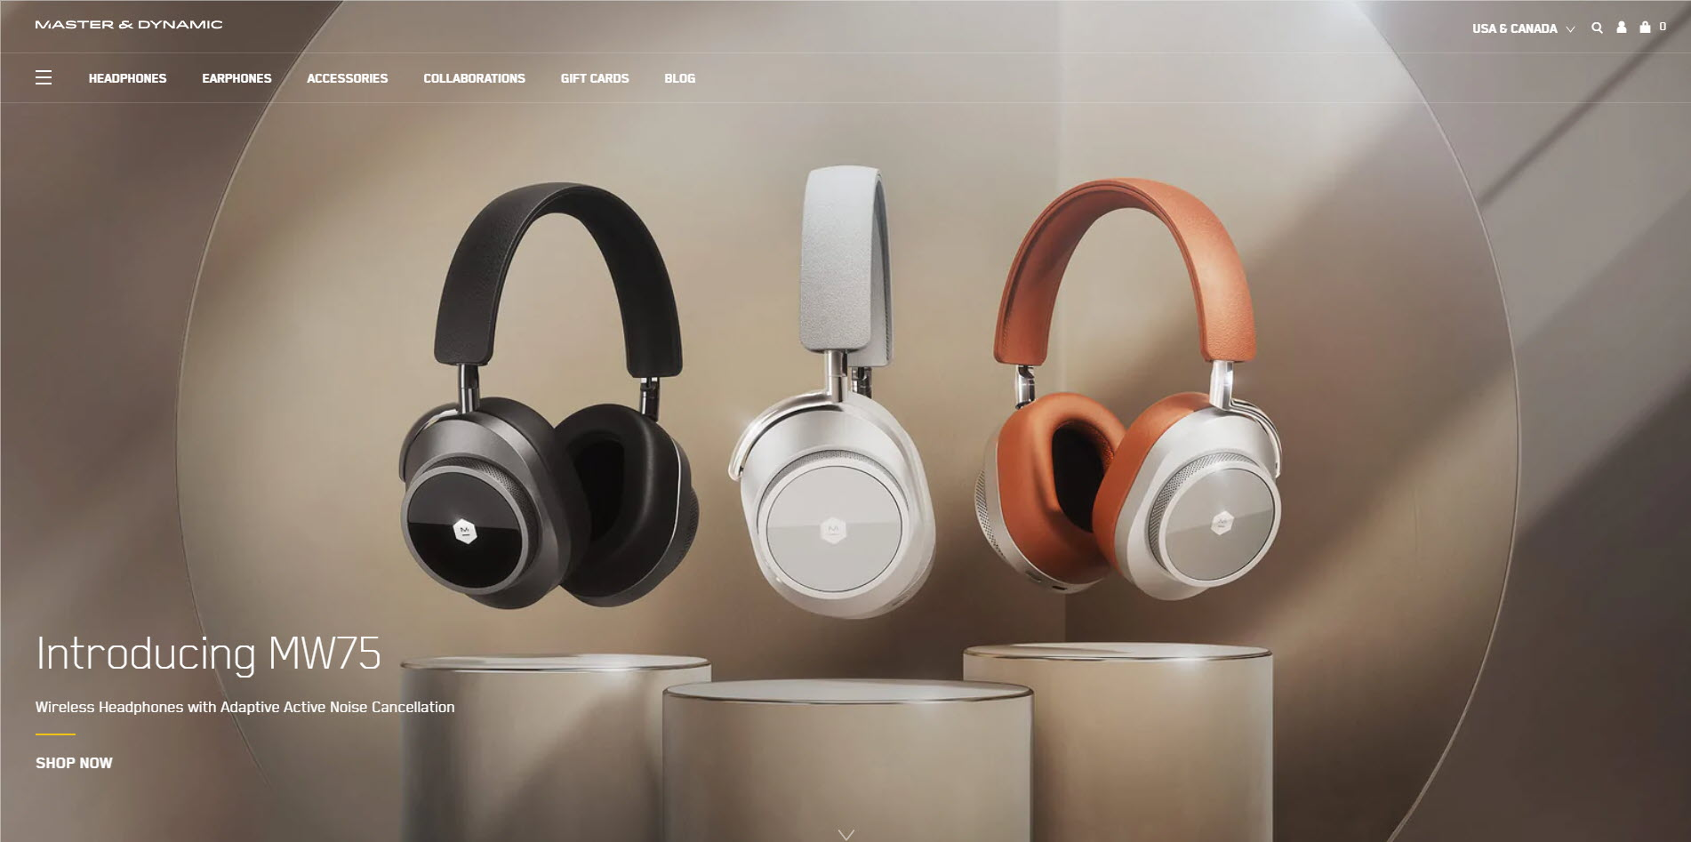
Professional Ecommerce Website that makes your business as a
Fastest-Growing Business
Whatever the size of your organization, a website is an essential business tool.
However, having a good-looking site is no longer enough - it needs to actively work for you by attracting new business and driving your company forward.
Here are 9 steps to ensure your website works hard for your business.

Slide 2
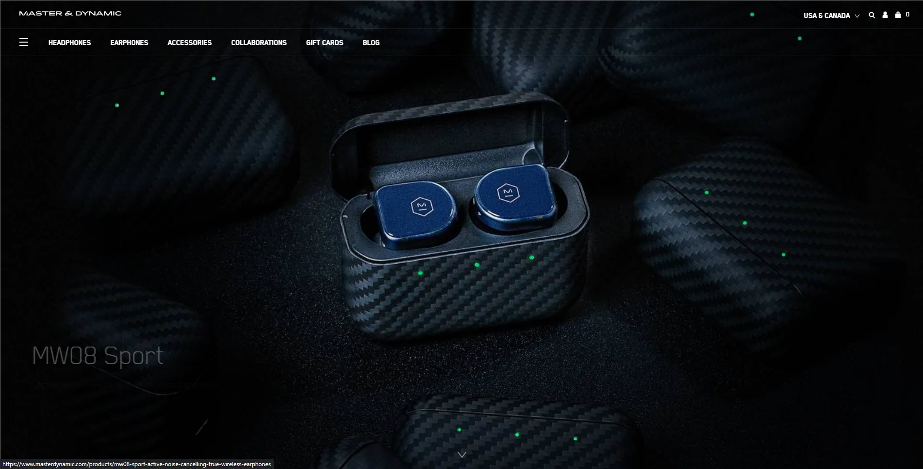


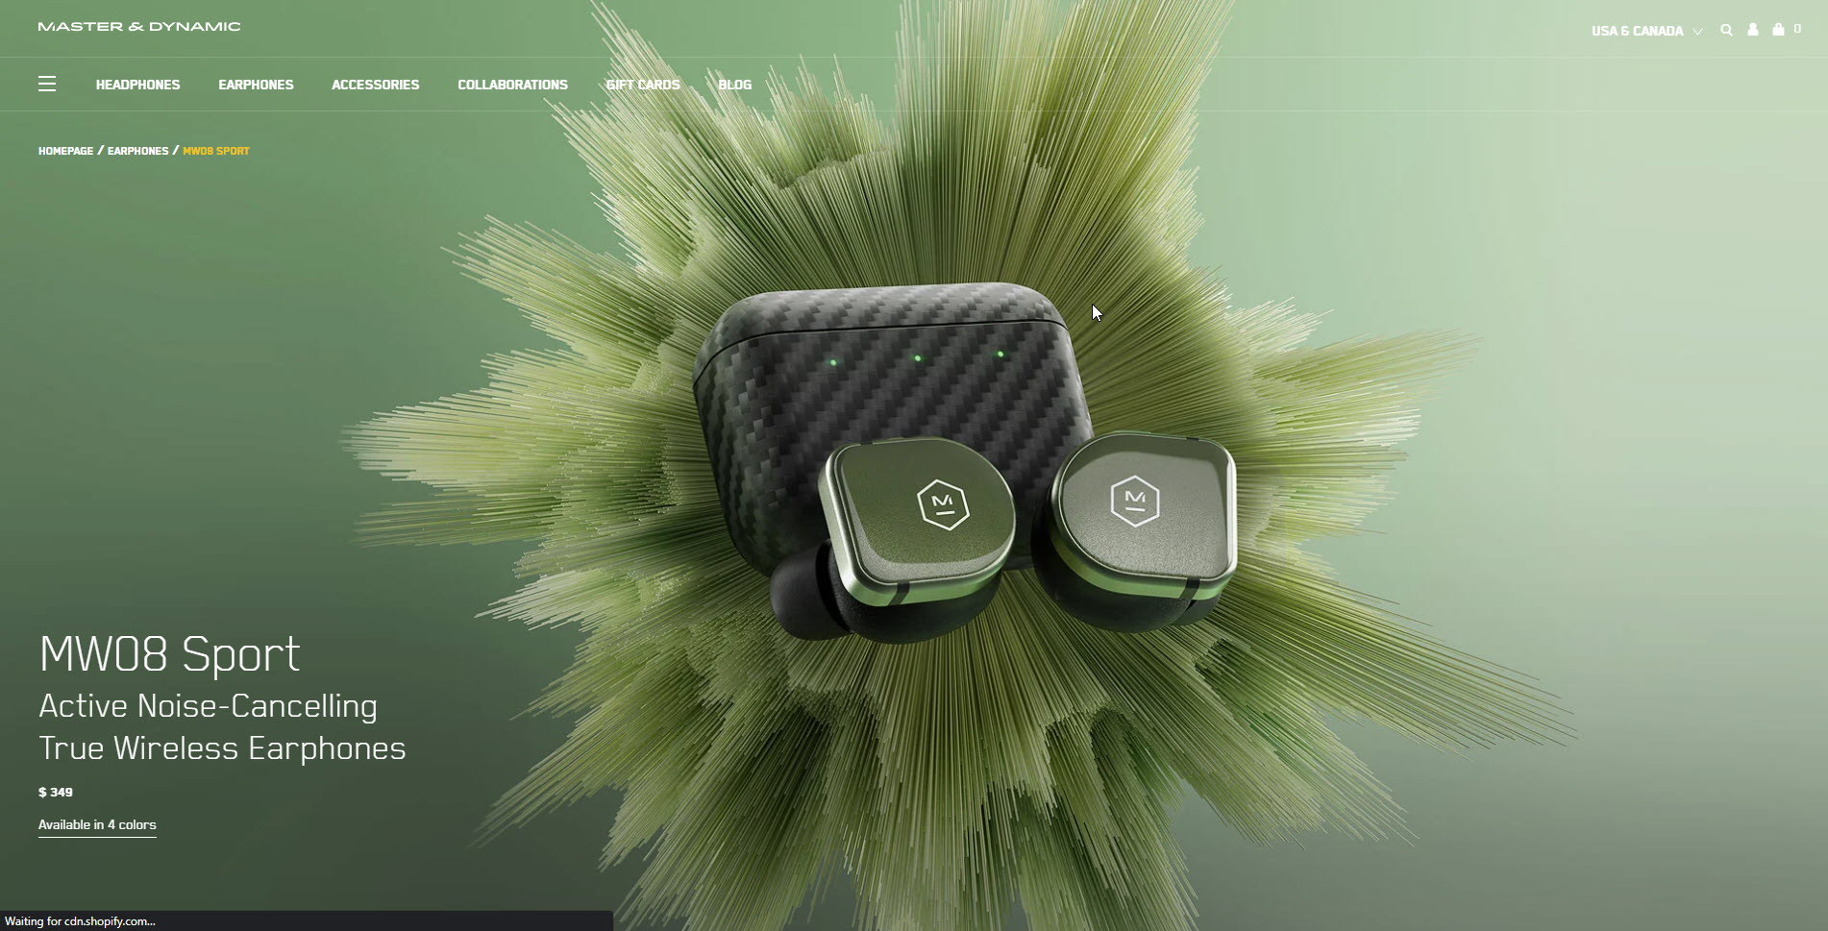
Make a site Business Driven.
Website is a business tool, and whilst good design is important, first and foremost it should be business-led.
Increasingly, current and potential customers engage
with a company via website,
so think of it as your showcase.
Consistent branding and developing
a defined identity starts with your website and is then carried on through marketing, stationery, brochures and other activity.
01

Slide 3

Review and reflect on design
Does your site reflect changes in the marketplace?
Does it still address your target market?
Are the design, content and graphics still relevant?
Does it accurately showcase your business?
02

Slide 4


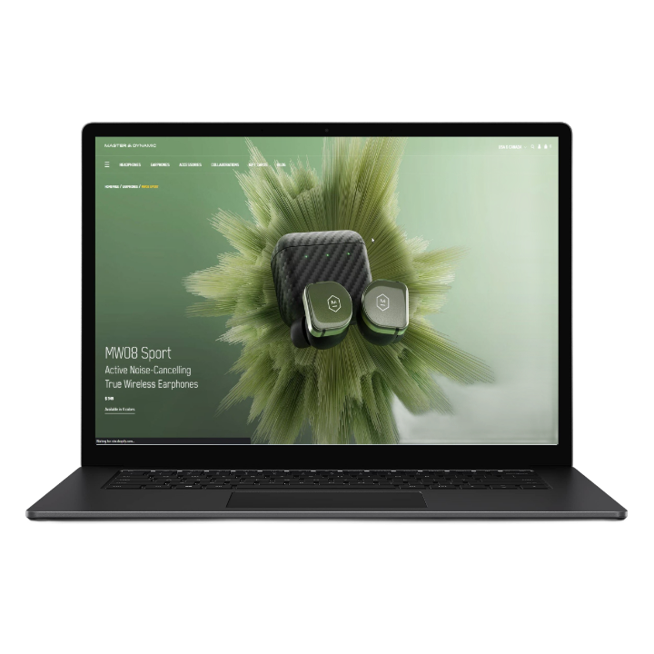
Differentiate through design
Great design is also another way that you can really differentiate yourself from the competition.
Make your site looks attractive and professional, as well as being functional. Ultimately, this will increase visitors, page view rates - and new business.
03

Slide 5

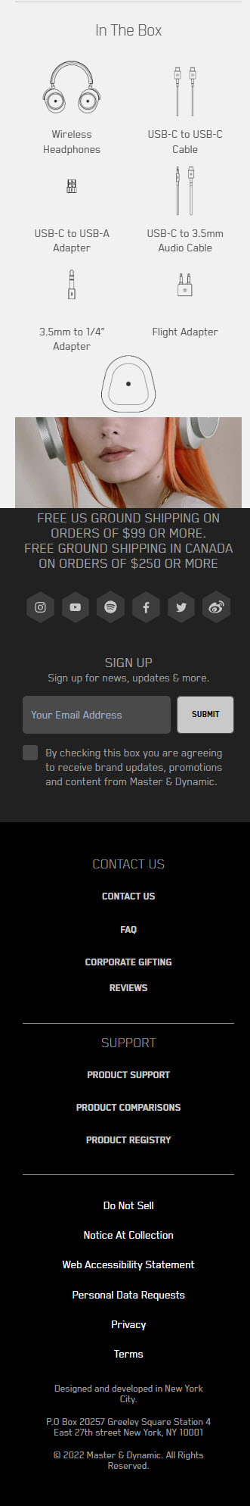




Make a site Mobile friendly.
04

Slide 6


Make a site Business Driven.
05
“A website should be continually developing”

Slide 7
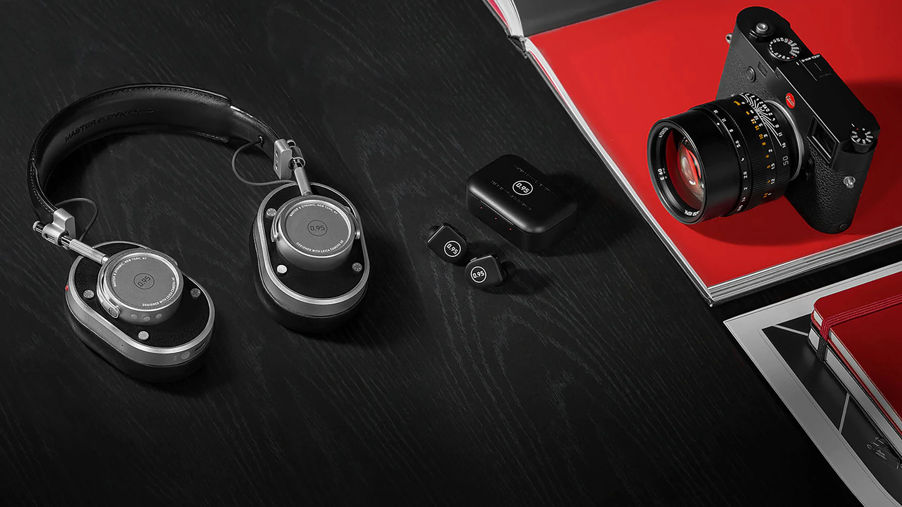
Make the most of online marketing
Make a site Business Driven.
A website should be continually developing.
The internet is essentially demand-led,
With SEO you can get more bang for your buck on the internet than advertising in a magazine.
Choose the media and tactics that work best for
your business.
01
06

Slide 8

Aim to improve your ranking
07
Make your site is picked up by people through search engines.

Slide 9

They say the world is now in our hands, and the information is at our fingertips. The internet is fantastic and continues to transform the way we connect with people, share information,
and live a quality life.
This could be for buying a product, using a service, reading a blog, entertaining themselves, or for various other reasons.
Considering the amount of time people spend
on the internet,
businesses too have moved online.
Having a website with a presence on social media has become the need of the hour.
If you are a business owner and do not own a website, you might be losing a lot of potential customers online.
Therefore, knowing the importance
of a website is key to
growing your business exponentially
From <https://www.infidigit.com/blog/importance-of-website/>

